Slide 1


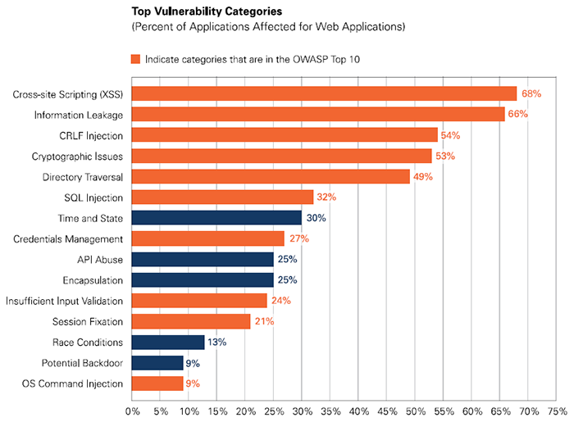
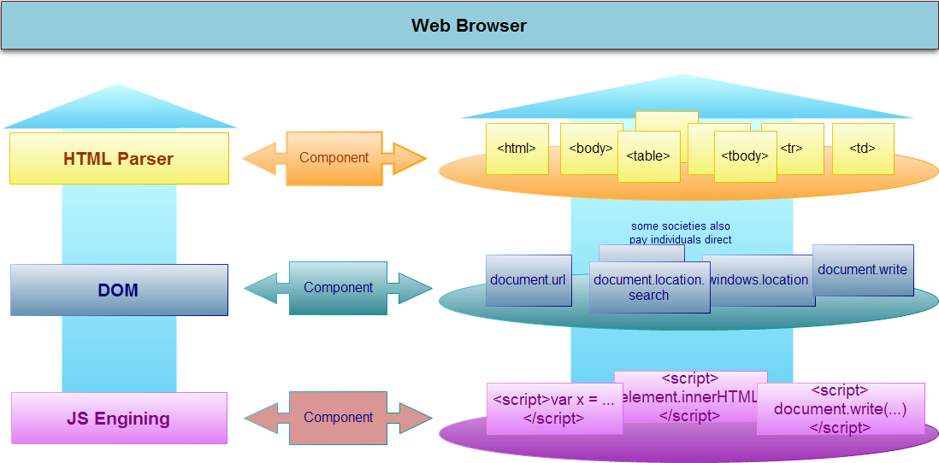
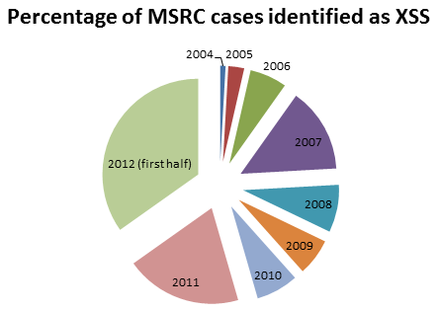

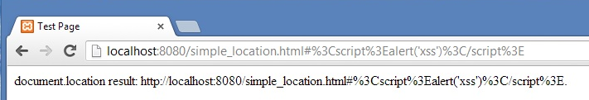

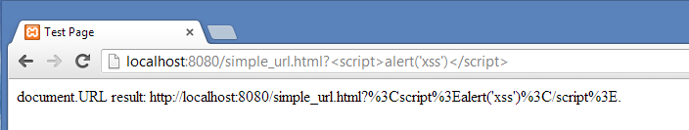
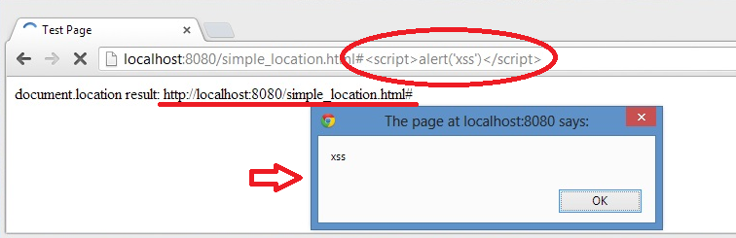
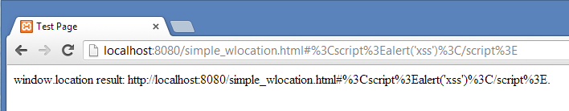
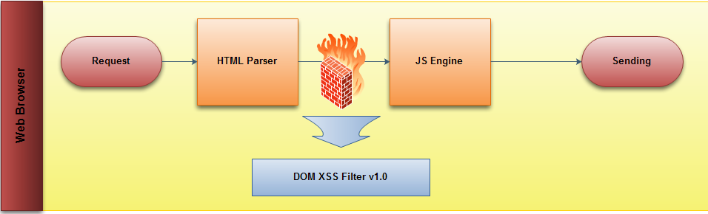
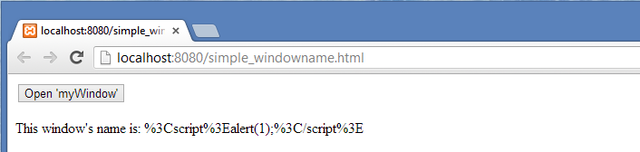
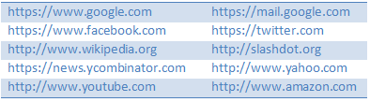
DOM-based XSS Filter
Heryandi, Lu Fangjian, Yang Yuhang, Yang Zhaoyu
School of Computing, National University of Singapore
Web Apps Attack Trends
Approach Overview
Implementation
Browser
Google Chrome version 26.0.1410.43 m & 27.0.1453.9 m
JavaScript
Chrome Extension API
chrome.webRequest
Content Script
Result
DOM-based XSS is different from
stored XSS and reflected XSS
The payload is in the client browser resulting in modifying DOM ENV.
Attack entirely within the browser in contrast to others depending on
server response.
Our Solution: Protect access to unsafe inputs!
Remove Referer from HTTP header
Intercept and remove by chrome.webRequest API
Protect access to unsafe inputs: encode the return value.
Chrome Content Script
Before DOM objects are constructed, inject small amount of JavaScript to…
Override document.URL getter
Override document.URLUnencoded getter
Protect document.location:
document.location.search already encoded
Override document.location.hash getter
Override window.name getter
Force encode window.location.hash
Evaluation
Efficiency: 1.5 page of un-minified code
Flexibility: Plain JavaScript & Chrome API
Compatibility: Tested with 10 websites
Effectiveness: See Result
Goal
Intercept and handle potential vulnerability with minimal impact on user experience.
Efficiency: No significant overhead
Flexibility: Ease to maintain
Compatibility: Compatible with most websites
Effectiveness: Protection from DOM-based XSS

